Slide 1
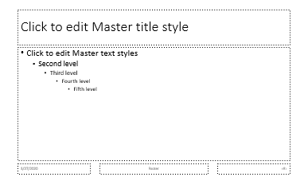
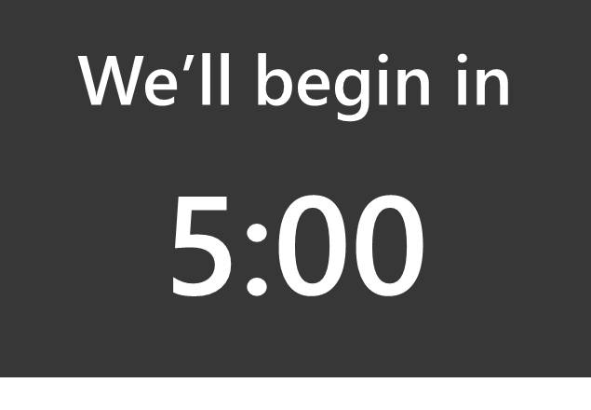
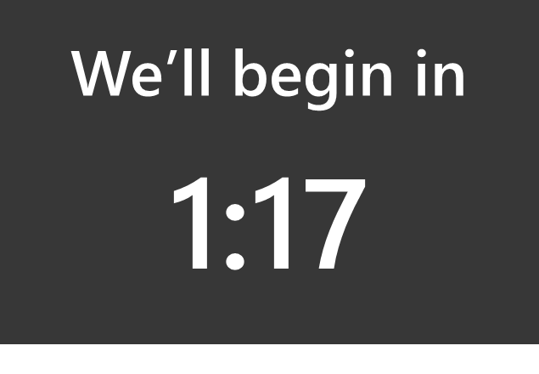
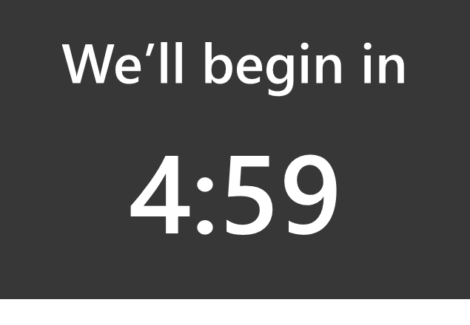
Countdown Slide Deck Instructions
This deck is built using a PowerPoint Slide Master for the background image, and an individual slide set to transition at one second for each 1-second countdown. Using a Slide Master lets you customize the underlying master slide without modifying 300 individual slides.
HIDDEN
Slide Master holds your slide background, text, content
Individual slides with text boxes counting down from 5:00 to 0:00
300 slides with your personalized slide background, advancing each second
+
=
Bonus Tip!
To make a countdown video, delete slide 1, then go to File > Save As and choose .MP4 as the file type.
To Modify the Slide Master
On the View tab, select Slide Master
Select all the objects on the slide in your deck and paste into the Slide Master
If your source deck uses a slide master, you’ll need to got to View > Slide Master in the source deck and copy any background images, text placeholders, and object
Remember to Keep Source Formatting when you paste from your source deck
To Run the Countdown
Run the slideshow
The first slide is set to transition On Mouse Click and doesn’t have a countdown box. Start the show (on the first slide), wait until t-minus 5 minutes, then advance the slide. PowerPoint will advance to Slide 3.
The last slide is also set to transition On Mouse Click, so when the countdown ends, the slideshow will pause there until you advance or exit the slide show.
Tip – Skip to the Correct Time
During a PowerPoint show, if you type a number and press enter, PowerPoint will skip to that slide, e.g. typing “1 5 [enter]” will advance to slide 15. Type the number below and press enter while the slideshow is running to advance to that time in the countdown.
Time | Slide # |  | Time | Slide #
5:00 | 1 |  | 2:30 | 153
4:30 | 33 |  | 2:00 | 183
4:00 | 63 |  | 1:30 | 213
3:30 | 93 |  | 1:00 | 243
3:00 | 123 |  | 0:30 | 273
Other Tips: You can of course achieve this effect with a timer app running on top of the slideshow, like the Win10 Alarms & Clock App. It’s a best practice to keep this deck separate from your main deck (so you don’t have hundreds of extra slides.) Advanced users can use a Hyperlink or Action Button to link between decks; Slide Sections to separate their content slides and countdown slides; and/or PowerPoint Zoom to navigate between sections. If you’re screen sharing in an online meeting, there will be some minor latency in the per-second screen updates, but the overall countdown will be accurate. Email Nick Stillings with questions
(This assumes you haven’t added or deleted any slides to the 304 in this deck! Adjust accordingly if you have.)

Slide 3
We’ll begin in
5:00

Slide 4
We’ll begin in
4:59

Slide 5
We’ll begin in
4:58

Slide 6
We’ll begin in
4:57

Slide 7
We’ll begin in
4:56

Slide 8
We’ll begin in
4:55

Slide 9
We’ll begin in
4:54

Slide 10
We’ll begin in
4:53

Slide 11
We’ll begin in
4:52

Slide 12
We’ll begin in
4:51

Slide 13
We’ll begin in
4:50

Slide 14
We’ll begin in
4:49

Slide 15
We’ll begin in
4:48

Slide 16
We’ll begin in
4:47

Slide 17
We’ll begin in
4:46

Slide 18
We’ll begin in
4:45

Slide 19
We’ll begin in
4:44

Slide 20
We’ll begin in
4:43

Slide 21
We’ll begin in
4:42

Slide 22
We’ll begin in
4:41

Slide 23
We’ll begin in
4:40

Slide 24
We’ll begin in
4:39

Slide 25
We’ll begin in
4:38

Slide 26
We’ll begin in
4:37

Slide 27
We’ll begin in
4:36

Slide 28
We’ll begin in
4:35

Slide 29
We’ll begin in
4:34

Slide 30
We’ll begin in
4:33

Slide 31
We’ll begin in
4:32

Slide 32
We’ll begin in
4:31

Slide 33
We’ll begin in
4:30

Slide 34
We’ll begin in
4:29

Slide 35
We’ll begin in
4:28

Slide 36
We’ll begin in
4:27

Slide 37
We’ll begin in
4:26

Slide 38
We’ll begin in
4:25

Slide 39
We’ll begin in
4:24

Slide 40
We’ll begin in
4:23

Slide 41
We’ll begin in
4:22

Slide 42
We’ll begin in
4:21

Slide 43
We’ll begin in
4:20

Slide 44
We’ll begin in
4:19

Slide 45
We’ll begin in
4:18

Slide 46
We’ll begin in
4:17

Slide 47
We’ll begin in
4:16

Slide 48
We’ll begin in
4:15

Slide 49
We’ll begin in
4:14

Slide 50
We’ll begin in
4:13

Slide 51
We’ll begin in
4:12

Slide 52
We’ll begin in
4:11

Slide 53
We’ll begin in
4:10

Slide 54
We’ll begin in
4:09

Slide 55
We’ll begin in
4:08

Slide 56
We’ll begin in
4:07

Slide 57
We’ll begin in
4:06

Slide 58
We’ll begin in
4:05

Slide 59
We’ll begin in
4:04

Slide 60
We’ll begin in
4:03

Slide 61
We’ll begin in
4:02

Slide 62
We’ll begin in
4:01

Slide 63
We’ll begin in
4:00

Slide 64
We’ll begin in
3:59

Slide 65
We’ll begin in
3:58

Slide 66
We’ll begin in
3:57

Slide 67
We’ll begin in
3:56

Slide 68
We’ll begin in
3:55

Slide 69
We’ll begin in
3:54

Slide 70
We’ll begin in
3:53

Slide 71
We’ll begin in
3:52

Slide 72
We’ll begin in
3:51

Slide 73
We’ll begin in
3:50

Slide 74
We’ll begin in
3:49

Slide 75
We’ll begin in
3:48

Slide 76
We’ll begin in
3:47

Slide 77
We’ll begin in
3:46

Slide 78
We’ll begin in
3:45

Slide 79
We’ll begin in
3:44

Slide 80
We’ll begin in
3:43

Slide 81
We’ll begin in
3:42

Slide 82
We’ll begin in
3:41

Slide 83
We’ll begin in
3:40

Slide 84
We’ll begin in
3:39

Slide 85
We’ll begin in
3:38

Slide 86
We’ll begin in
3:37

Slide 87
We’ll begin in
3:36

Slide 88
We’ll begin in
3:35

Slide 89
We’ll begin in
3:34

Slide 90
We’ll begin in
3:33

Slide 91
We’ll begin in
3:32

Slide 92
We’ll begin in
3:31

Slide 93
We’ll begin in
3:30

Slide 94
We’ll begin in
3:29

Slide 95
We’ll begin in
3:28

Slide 96
We’ll begin in
3:27

Slide 97
We’ll begin in
3:26

Slide 98
We’ll begin in
3:25

Slide 99
We’ll begin in
3:24

Slide 100
We’ll begin in
3:23

Slide 101
We’ll begin in
3:22

Slide 102
We’ll begin in
3:21

Slide 103
We’ll begin in
3:20

Slide 104
We’ll begin in
3:19

Slide 105
We’ll begin in
3:18

Slide 106
We’ll begin in
3:17

Slide 107
We’ll begin in
3:16

Slide 108
We’ll begin in
3:15

Slide 109
We’ll begin in
3:14

Slide 110
We’ll begin in
3:13

Slide 111
We’ll begin in
3:12

Slide 112
We’ll begin in
3:11

Slide 113
We’ll begin in
3:10

Slide 114
We’ll begin in
3:09

Slide 115
We’ll begin in
3:08

Slide 116
We’ll begin in
3:07

Slide 117
We’ll begin in
3:06

Slide 118
We’ll begin in
3:05

Slide 119
We’ll begin in
3:04

Slide 120
We’ll begin in
3:03

Slide 121
We’ll begin in
3:02

Slide 122
We’ll begin in
3:01

Slide 123
We’ll begin in
3:00

Slide 124
We’ll begin in
2:59

Slide 125
We’ll begin in
2:58

Slide 126
We’ll begin in
2:57

Slide 127
We’ll begin in
2:56

Slide 128
We’ll begin in
2:55

Slide 129
We’ll begin in
2:54

Slide 130
We’ll begin in
2:53

Slide 131
We’ll begin in
2:52

Slide 132
We’ll begin in
2:51

Slide 133
We’ll begin in
2:50

Slide 134
We’ll begin in
2:49

Slide 135
We’ll begin in
2:48

Slide 136
We’ll begin in
2:47

Slide 137
We’ll begin in
2:46

Slide 138
We’ll begin in
2:45

Slide 139
We’ll begin in
2:44

Slide 140
We’ll begin in
2:43

Slide 141
We’ll begin in
2:42

Slide 142
We’ll begin in
2:41

Slide 143
We’ll begin in
2:40

Slide 144
We’ll begin in
2:39

Slide 145
We’ll begin in
2:38

Slide 146
We’ll begin in
2:37

Slide 147
We’ll begin in
2:36

Slide 148
We’ll begin in
2:35

Slide 149
We’ll begin in
2:34

Slide 150
We’ll begin in
2:33

Slide 151
We’ll begin in
2:32

Slide 152
We’ll begin in
2:31

Slide 153
We’ll begin in
2:30

Slide 154
We’ll begin in
2:29

Slide 155
We’ll begin in
2:28

Slide 156
We’ll begin in
2:27

Slide 157
We’ll begin in
2:26

Slide 158
We’ll begin in
2:25

Slide 159
We’ll begin in
2:24

Slide 160
We’ll begin in
2:23

Slide 161
We’ll begin in
2:22

Slide 162
We’ll begin in
2:21

Slide 163
We’ll begin in
2:20

Slide 164
We’ll begin in
2:19

Slide 165
We’ll begin in
2:18

Slide 166
We’ll begin in
2:17

Slide 167
We’ll begin in
2:16

Slide 168
We’ll begin in
2:15

Slide 169
We’ll begin in
2:14

Slide 170
We’ll begin in
2:13

Slide 171
We’ll begin in
2:12

Slide 172
We’ll begin in
2:11

Slide 173
We’ll begin in
2:10

Slide 174
We’ll begin in
2:09

Slide 175
We’ll begin in
2:08

Slide 176
We’ll begin in
2:07

Slide 177
We’ll begin in
2:06

Slide 178
We’ll begin in
2:05

Slide 179
We’ll begin in
2:04

Slide 180
We’ll begin in
2:03

Slide 181
We’ll begin in
2:02

Slide 182
We’ll begin in
2:01

Slide 183
We’ll begin in
2:00

Slide 184
We’ll begin in
1:59

Slide 185
We’ll begin in
1:58

Slide 186
We’ll begin in
1:57

Slide 187
We’ll begin in
1:56

Slide 188
We’ll begin in
1:55

Slide 189
We’ll begin in
1:54

Slide 190
We’ll begin in
1:53

Slide 191
We’ll begin in
1:52

Slide 192
We’ll begin in
1:51

Slide 193
We’ll begin in
1:50

Slide 194
We’ll begin in
1:49

Slide 195
We’ll begin in
1:48

Slide 196
We’ll begin in
1:47

Slide 197
We’ll begin in
1:46

Slide 198
We’ll begin in
1:45

Slide 199
We’ll begin in
1:44

Slide 200
We’ll begin in
1:43

Slide 201
We’ll begin in
1:42

Slide 202
We’ll begin in
1:41

Slide 203
We’ll begin in
1:40

Slide 204
We’ll begin in
1:39

Slide 205
We’ll begin in
1:38

Slide 206
We’ll begin in
1:37

Slide 207
We’ll begin in
1:36

Slide 208
We’ll begin in
1:35

Slide 209
We’ll begin in
1:34

Slide 210
We’ll begin in
1:33

Slide 211
We’ll begin in
1:32

Slide 212
We’ll begin in
1:31

Slide 213
We’ll begin in
1:30

Slide 214
We’ll begin in
1:29

Slide 215
We’ll begin in
1:28

Slide 216
We’ll begin in
1:27

Slide 217
We’ll begin in
1:26

Slide 218
We’ll begin in
1:25

Slide 219
We’ll begin in
1:24

Slide 220
We’ll begin in
1:23

Slide 221
We’ll begin in
1:22

Slide 222
We’ll begin in
1:21

Slide 223
We’ll begin in
1:20

Slide 224
We’ll begin in
1:19

Slide 225
We’ll begin in
1:18

Slide 226
We’ll begin in
1:17

Slide 227
We’ll begin in
1:16

Slide 228
We’ll begin in
1:15

Slide 229
We’ll begin in
1:14

Slide 230
We’ll begin in
1:13

Slide 231
We’ll begin in
1:12

Slide 232
We’ll begin in
1:11

Slide 233
We’ll begin in
1:10

Slide 234
We’ll begin in
1:09

Slide 235
We’ll begin in
1:08

Slide 236
We’ll begin in
1:07

Slide 237
We’ll begin in
1:06

Slide 238
We’ll begin in
1:05

Slide 239
We’ll begin in
1:04

Slide 240
We’ll begin in
1:03

Slide 241
We’ll begin in
1:02

Slide 242
We’ll begin in
1:01

Slide 243
We’ll begin in
1:00

Slide 244
We’ll begin in
0:59

Slide 245
We’ll begin in
0:58

Slide 246
We’ll begin in
0:57

Slide 247
We’ll begin in
0:56

Slide 248
We’ll begin in
0:55

Slide 249
We’ll begin in
0:54

Slide 250
We’ll begin in
0:53

Slide 251
We’ll begin in
0:52

Slide 252
We’ll begin in
0:51

Slide 253
We’ll begin in
0:50

Slide 254
We’ll begin in
0:49

Slide 255
We’ll begin in
0:48

Slide 256
We’ll begin in
0:47

Slide 257
We’ll begin in
0:46

Slide 258
We’ll begin in
0:45

Slide 259
We’ll begin in
0:44

Slide 260
We’ll begin in
0:43

Slide 261
We’ll begin in
0:42

Slide 262
We’ll begin in
0:41

Slide 263
We’ll begin in
0:40

Slide 264
We’ll begin in
0:39

Slide 265
We’ll begin in
0:38

Slide 266
We’ll begin in
0:37

Slide 267
We’ll begin in
0:36

Slide 268
We’ll begin in
0:35

Slide 269
We’ll begin in
0:34

Slide 270
We’ll begin in
0:33

Slide 271
We’ll begin in
0:32

Slide 272
We’ll begin in
0:31

Slide 273
We’ll begin in
0:30

Slide 274
We’ll begin in
0:29

Slide 275
We’ll begin in
0:28

Slide 276
We’ll begin in
0:27

Slide 277
We’ll begin in
0:26

Slide 278
We’ll begin in
0:25

Slide 279
We’ll begin in
0:24

Slide 280
We’ll begin in
0:23

Slide 281
We’ll begin in
0:22

Slide 282
We’ll begin in
0:21

Slide 283
We’ll begin in
0:20

Slide 284
We’ll begin in
0:19

Slide 285
We’ll begin in
0:18

Slide 286
We’ll begin in
0:17

Slide 287
We’ll begin in
0:16

Slide 288
We’ll begin in
0:15

Slide 289
We’ll begin in
0:14

Slide 290
We’ll begin in
0:13

Slide 291
We’ll begin in
0:12

Slide 292
We’ll begin in
0:11

Slide 293
We’ll begin in
0:10

Slide 294
We’ll begin in
0:09

Slide 295
We’ll begin in
0:08

Slide 296
We’ll begin in
0:07

Slide 297
We’ll begin in
0:06

Slide 298
We’ll begin in
0:05

Slide 299
We’ll begin in
0:04

Slide 300
We’ll begin in
0:03

Slide 301
We’ll begin in
0:02

Slide 302
We’ll begin in
0:01

Slide 303
We’ll begin in
0:00

Slide 304

We’ll begin in
0:00
Starting…

Slide 305
We’ll begin in
Starting…

